Slide 1

JUMIA SMARTPHONE PRICE PREDICTION: OPTIMIZING RETAIL STRATEGIES THROUGH DATA ANALYTICS

Slide 2

Outline
Business Understanding
Modelling
Model Evaluation: Model of Choice
Deployment
Conclusion & Recommendations
Data Understanding & preparation

Slide 3
Overview
The African e-commerce market led by platforms like Jumia has experienced rapid growth with over 100,000 retailers competing for consumer attention.
Retailers are struggling to develop effective pricing strategies due to the complexity of dynamic market conditions and limited tools for real time pricing evaluations.
The proposed solution is a predictive pricing model that leverages sales data, competitor prices and market trends to automate and optimize pricing decisions.

Slide 4

Business Problem
Retailers on Jumia are struggling with pricing strategies due to intense competition and changing market conditions, with slow and inefficient pricing evaluation methods. To address this, we aim to develop a predictive pricing model using sales data, competitor prices, and market trends. This will automate pricing evaluations, helping retailers set competitive prices and improve performance during peak periods like Black Friday, ultimately giving them the tools to succeed in the competitive e-commerce landscape

Slide 5
Objectives
Develop a predictive model to forecast optimal smartphone pricing based on key product features.
1
Analyze sales and pricing data to identify key factors in consumer decisions and pricing trends
2
Analyze the smartphone market in detail to identify the most dominant smartphone brand on the Jumia platform.
3

Slide 6
Data Understanding
The data was scrapped from Jumia KE on 31-oct-2024 focusing on 12,000 smartphones listed by popularity. The data is saved in CSV and available for review in the data repository.
Key product features were extracted and organized from the product name column to gain insights into each phone’s features. This was done using Regular expression module.
A structured data frame was created and numerical data extracted from Rating, Number of Reviews and Search Ranking column for further analysis.

Slide 7
Data Preparation
The Dataset was cleaned for duplicates and missing values, revealing the following key insights:
Screen Size: Most phones have an average screen size of 6.6 inches (5.0–6.88 inches).
RAM: 4 GB is the most common ( 1 GB to 8 GB range).
Storage (ROM): 128 GB is standard, with some phones offering 32 GB to 256 GB.
Warranty: Most phones come with a 1-year warranty, some with 2 years, and a few with no warranty.
Price: The average price is KES 13,735, with most phones priced between KES 10,000–15,000.
Rating: Average rating of 4.3, indicating positive feedback.
Reviews: Average number of reviews is 79, with some phones receiving hundreds.
Page Listings: Phones span 1–300 pages, showing a wide range of options.
Rank: Phones typically rank between 1 and 30, indicating competitive listings.
Overall, the Market is dominated by mid-range phones with standard features

Slide 8
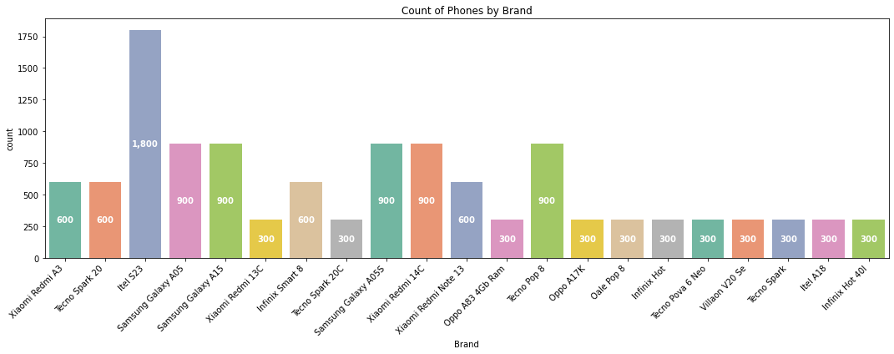
Count of Phones by Brand
Itel S23 appears to be the most listed product which could possibly imply that this phone is a fast-moving product due to demand among customers on the platform followed by Samsung Galaxy A05, XIOMI Redmi 14C, Samsung Galaxy A15 and Tecno POP 8 at a very close range which highlights the competitive landscape in this segment.
These findings could inform inventory decisions and marketing strategies to enhance visibility and sales for these trending products.

Slide 9
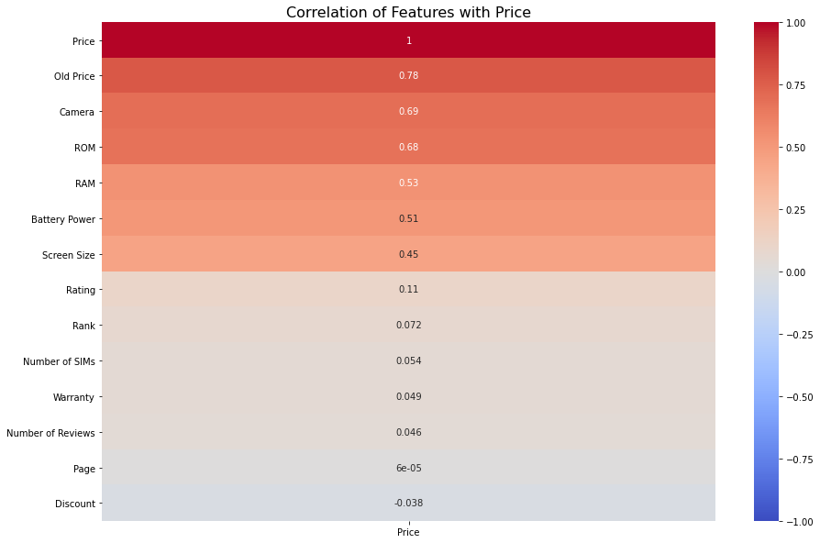
Correlation of Features with Price

Slide 10
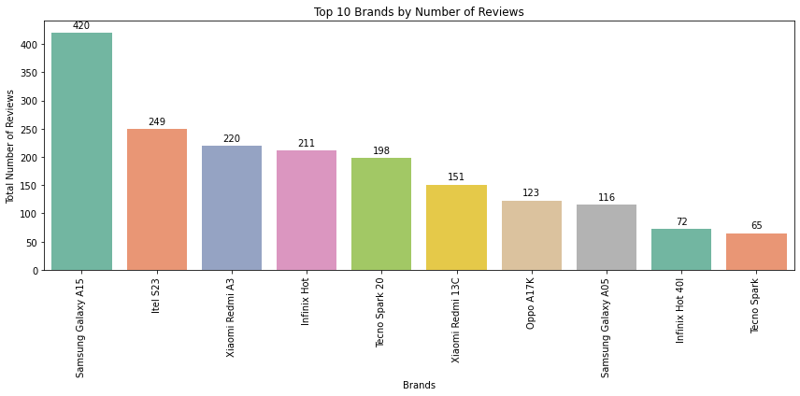
Top 10 Brands by Number of Reviews
Samsung Galaxy A15 leads with over 400 reviews, followed by Itel S23 with 250. Xiaomi Redmi A3 and Infinix Hot have around 200 reviews, while other models, like Tecno Spark, have fewer. Possibly suggesting greater consumer interest in the Galaxy A15 and Itel S23.

Slide 11
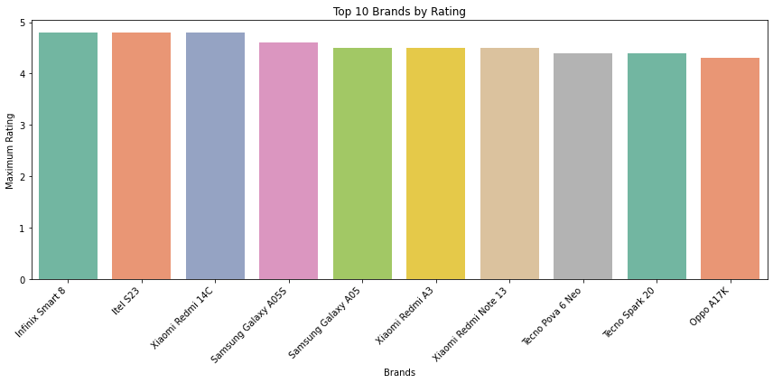
Top 10 Brands by Rating The bar plot shows the top 10 smartphone brands with maximum ratings near 5, indicating high customer satisfaction and performance across their top brands, highlighting a competitive market.

Slide 12
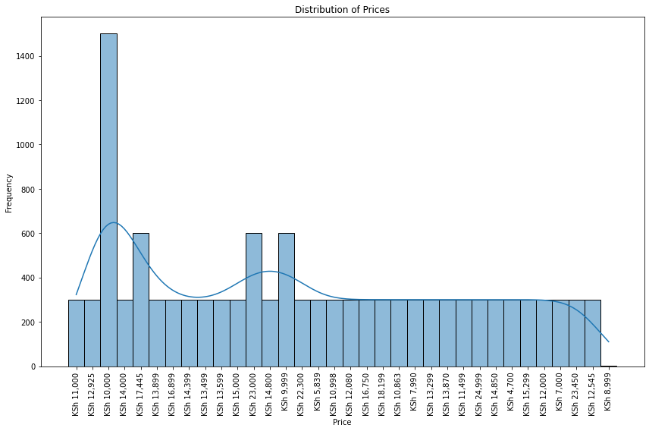

Distribution of Prices The histogram shows that most prices are concentrated around KES 11,000, with fewer phones priced higher, creating a right-skewed distribution.

Slide 13
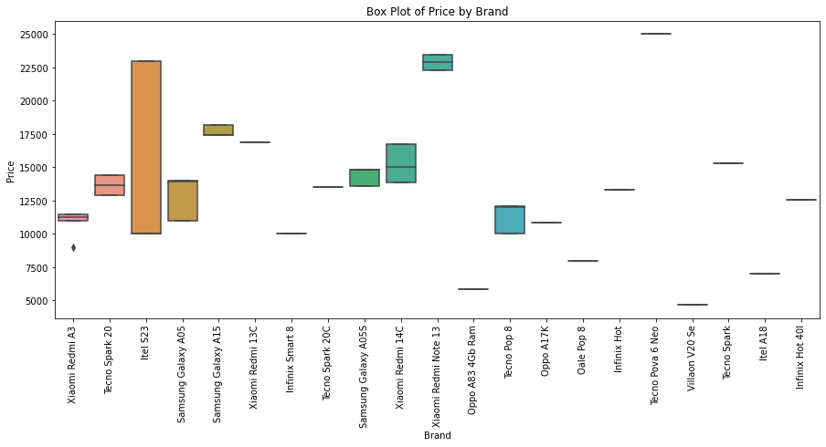

Box Plot of Price by Brand The box plot shows that some brands, like Itel and Samsung, have wide price ranges, while others, like Oppo and Infinix, have narrower ones. Budget-friendly models like Tecno Spark and Xiaomi Redmi A3 stand out, with occasional price outliers

Slide 14

Modeling
Modeling algorithms used:
Linear Regression
Polynomial Regression
Random Forest
Decision Tree Regressor
Gradient Boosting Regressor
Extreme Gradient Boost
Neural Networks

Slide 15



Model Selection
Metrics:
Mean Squared Error (MSE):
Mean Absolute Error (MAE):
R-squared (R²):

Slide 16
Results: While all the models perform similarly with almost identical test metrics, Random Forest stands out slightly due to its lowest MAE (Mean Absolute Error) and MSE (Mean Squared Error). This indicates that, on average, Random Forest delivers more accurate predictions compared to the other models.
 | Train Split
Model | MAE | MSE | R² Score
Linear Reg
Polynomial Reg
Decision Tree
Random Forest
Gradient Boosting Reg
Extreme Gradient Boost
Neural Networks
Results:

Slide 17
Model Deployment in Web Environment

Slide 18
Future Work and Limitations
Dynamic pricing: The price data is static and may not reflect real-time market changes. Periodic data collection or real-time updates would provide more accurate insights.
Incomplete data: Variability in phone listings, such as missing details, could skew comparisons and affect value assessments. Standardizing data collection and validation would improve consistency.
Unverified ratings: Insights from ratings and reviews may be biased or unreliable. Using verified reviews and additional metrics, like sales data, would provide a more accurate assessment.
Addressing these limitations would improve data reliability, leading to more accurate insights into price trends, brand popularity, and consumer preferences.

Slide 19

Conclusion
Features such as ROM, RAM, and screen size are key factors in determining phone pricing. To optimize pricing, sellers should consider these critical features in relation to market expectations and competition.
Product visibility within top ranks on a page has a more significant impact on customer engagement than the overall page placement.
While there is a weak positive relationship between pricing and the number of reviews, pricing alone is not a major driver of review volume. Other factors like product visibility and marketing play a more substantial role.

Slide 20

Recommendations
Holistic Pricing and Marketing Approach: Focus on strategic pricing, effective marketing, and visibility through ads, while adjusting based on market trends and customer preferences.
Feature-based Pricing Optimization: Tailor pricing based on key features like ROM, RAM, and screen size to ensure competitiveness in the market while aligning with customer expectations.
A data-driven approach combining these elements will lead to better retail strategies and higher performance in the competitive smartphone market.

Slide 21

Appreciation

